Slide 1
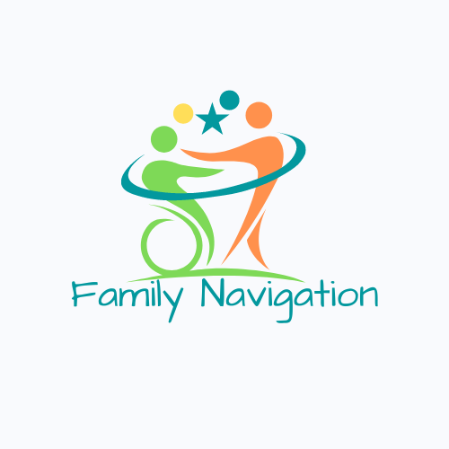
Family Navigation and Supports
Presented by: Tamico Jones, Randy Schraier, Cait Carr
Notes:
Navigation Intro – introduce one another and background/specialities

Slide 2
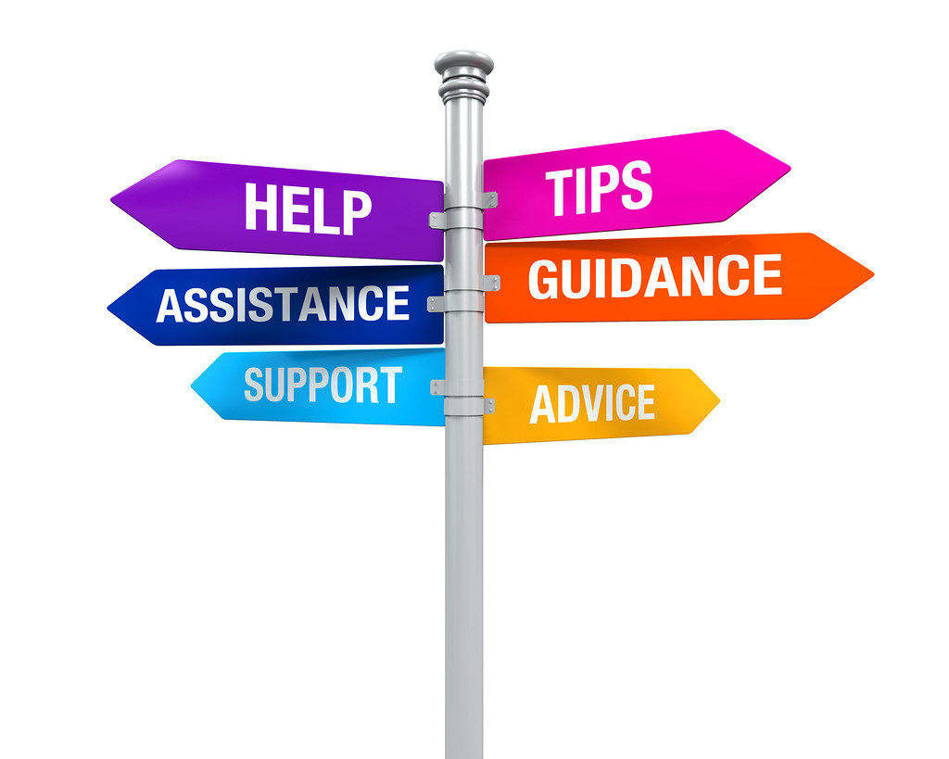
What is Family Navigation?
Family Navigation services provide families/individuals:
information on systems navigation
resources that meet their needs
advocacy training
support to complete or acquire required documentation
Family Navigators help individuals, and their families lead full lives that align with their personal goals.
Notes:
Cait -
Family Navigation began supporting individuals and their families in spring of 2020, amid the pandemic. Since that time, they’ve supported approximately (a little over) 1,000 unique cases.
A case is defined as one instance in which an individual/participant seeks and receives support on or behalf of the individual. Once that request is completed the case will be closed.
Each subsequent request for support related to a new or different need represents a new case. Each case is unique to that person/family and the need they are seeking to meet.
Family Navigation services are similar to those provided by our partners who provide Family Support (i.e., FACT, Delta Gamma, Down Syndrome Association & ESMW (individual/group services) – though differ slightly as they are designed to be short-term in nature and not meant to be consecutively ongoing. More intensive in nature – case by case – help overcome and then close

Slide 3
Why is Family Navigation Needed?
Families are unaware of services available to them. Family Navigation partners provide a detailed step by step instruction on how to access those services. Often, we are able to provide direct contacts to families supported.
Family Navigation is a FREE service to families in St. Louis County, supporting individuals of all ages. We can even support individuals who do not have an “official” diagnosis.
Family Navigation provides guidance through all aspects of getting connected to services, rather than giving someone a “list” of places to contact.
Notes:
Cait

Slide 4
Who provides Family Navigation Supports?
Easterseals Midwest
St. Louis ARC
Sunnyhill
UCP Heartland
Notes:
Randy

Slide 5
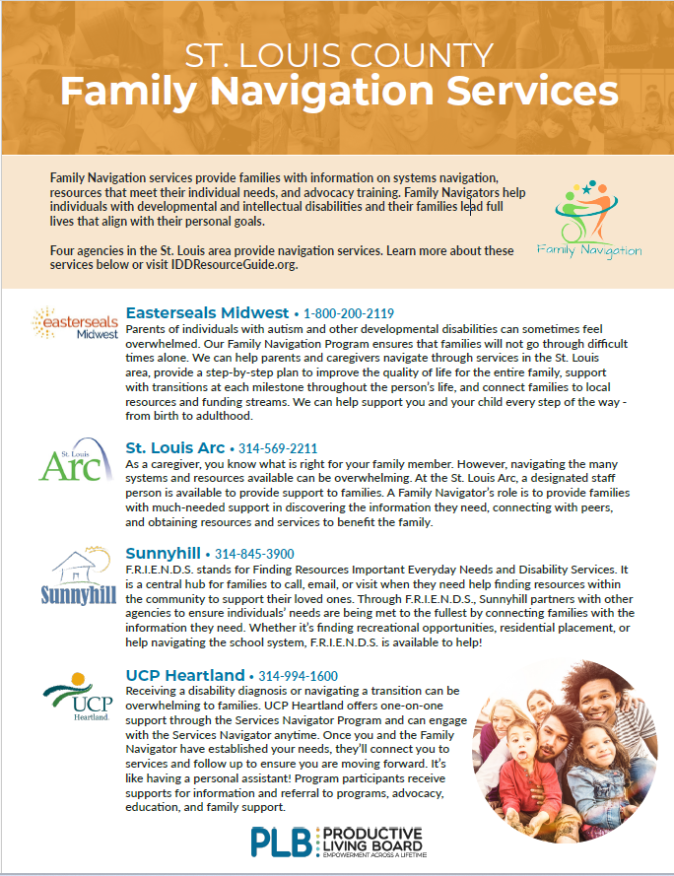
Notes:
Randy

Slide 6
When parents first learn their child has autism, they can feel lost, confused, and overwhelmed. ESMW’s Family Navigators are available to support families by creating an individualized plan that will allow their child to live a full, engaging life in the community.
ESMW’s Adult Family Navigators assist adults with disabilities as they transition to the next stages in life:
High School to post-secondary
Entering the workforce
Community living
Selecting a day program
Navigators meet with the individuals to speak about options and form a plan outlining next steps for families.
Notes:
Easterseals supports individuals through all stages of life, but the ways they provide navigation are different.
2 groups or teams of navigators: child/adolescent and adult
Depending on the service(s) or resources the participant is interested in, someone can start at the transition age or the age range of 16-18, working with an adult navigator.
To obtain more specific information about the participant and to bet a better understanding of the client, needs and situation, the navigator will gather information from the parent, guardian or adult such as:
Likes/dislikes
Future planning or next steps? Goals?
Sensory needs
Medical issues, if any
Demographics
Reason for contacting/needs needing to be addressed
(A much shorter version of an ISP or IEP)
Both child and adult Navigators connect families with other programs at Easterseals as well as throughout the community.

Slide 7
Family Navigators are available to provide support to families. Their role is to provide families with much needed support to:
Discover any information they need
Connect with peers
Obtain resources and services that will benefit the family
How a Family Navigator Can Support You and Your Family:
• Provide resource information specific to your family’s needs
• Referral to supporting programs
• Connection with peers through support group and direct connections
• Advocacy and navigation of your child’s education system
• Navigation of the Department of Mental Health (DMH)
Notes:
Cait -
The Arc serves individuals and their families throughout the lifespan. Because of this, we have family navigators that can help with navigation services for each life stage they transition to. Lee Anna is the family navigator for ages 0-11, I am the navigator for ages 12-18, Cait for ages 19-29, and Ann supports ages 30 up. We also have a navigator that specializes in residential services. As family navigators we connect families to Arc programs that fit their needs such as respite, programs in the children's department, transition, or aging, as well as area resources with other organizations that may fit their needs as well.
There is no “one size fits all” for resources, programs and supports. We have a wide array of supports and resources to share with families so that everyone’s needs and wants are not only being addressed but worked on.
So, what happens if a participant is working with a navigator and ages out of that particular age range…what happens next?
The navigators all collaborate and work together so the transition and flow of one navigator to another is smooth.
We work as a team to make sure everyone’s needs, wants, goals, etc. are being addressed and met.

Slide 8
F.R.I.E.N.D.S.
Stands for Finding Resources Important Everyday Needs and Disability Services - is a central hub for families to call, email, or visit when they need help finding resources within the community to help their loved ones. Through F.R.I.E.N.D.S., Sunnyhill partners with various agencies to ensure the needs of the developmentally disabled are being met to the fullest by connecting families with the information they need. Whether it's finding recreational opportunities, residential placement, or helping navigating the school system, F.R.I.E.N.D.S. is available to help!
Notes:
Tamico
Support all ages
Meet families where they are at; IE: home, coffee shop, work, my office, etc
Crisis cases….

Slide 9
Receiving a disability diagnosis or navigating a transition can be overwhelming to families. UCP Heartland offers a personal, one-on-one service through the Services Navigator Program. Families can start to engage our Services Navigator Program any time.
The UCP team connects individuals and families to programs and services.
They provide guidance on where to turn
Assist with assessing needs
Coordinate introductions
Provide information and determine the path to create an optimal service plan.
They remain connected throughout the process ensuring individual’s/family’s needs are met to their satisfaction.
Notes:
Randy

Slide 10
Collaboration – How do we collaborate with each other and partner agencies/supports?
Through meetings and education for families and individuals
Through committees and community supports
Through joint working sessions to improve community supports
Notes:
Randy

Slide 11
Connections – Where do we connect families and individuals to for support?
Regional Resources
Funding & Eligibility
Partner Agencies
Local/State Agencies
Peer/Family Connections and Support
Crisis Support
Employment Supports
Legal/Financial Support
Assistive Technology
Advocacy Opportunities
Professional Services (Therapy, Counseling, Early Intervention, ESOS, ABA)
Housing Supports
Community Living
Community Integration
Notes:
Cait
Another part that family navigators help with is bridging communication and connections with various other services and agencies.
This can be done is many ways and is specific to each family and client.
One way we help bridge connections and communication is to send an email, zoom or phone call with a service provider and the family. Introducing the family, their needs, wants, etc. to the provider. Not only takes stress off the family but helps connect them with the correct service. This can be done with many agencies, people, schools and much more.
One way is by speaking with case managers at DDRB, DDR and DMH/Regional Center. Case managers have an enormous case load and quite a lot on their plate. Bridging that communication between a family and the case manager often times gets things going at a faster rate and there is a better understanding.
Since I work with the transition age young adults, there are so many uncertainties and next steps that are either in the works or ahead. Which is very nerve wrecking for the young adult and their loved one. Helping bridge connection between agencies and the correct people, appropriate for that family and young adult is key.
More specifically, something I do a lot is talk with families and young adults about community living options, what agencies offer that particular service, how to obtain it, etc. There is so much that goes into a service and we try to break it down as much as possible so that it is more concrete and easier to understand.
Overall, connecting families and their loved one to a person, agency or service can look different for everyone. But the end goal is the same- to help connect one another with whatever service they are interested in.

Slide 12
Education of Individuals and Families Supported
Who/What do we educate?
Families in schools, IEPS, Rights
Individuals on services, funding, how to access them
Residential, Socialization, etc
Transition stages
Future Planning
Self-Advocacy
Where/How?
Meeting with individuals and families
In the community (school, local café, home, etc.)
Virtual
Hybrid
Office
Outline?
Develop a plan of action
Goals
Follow up
Notes:
Tamico
IDD Resource Education, etc….
As family navigators, part of our role is to help with IEP advocacy. As part of this we will meet with the family beforehand and walk through their rights as a caretaker. We discuss what they think would be best for their child's education, and what services they believe would benefit their child. We put an emphasis on creating a team environment with the school and family because everyone want's what is best for the child. We are also able to attend the IEP with the family. To either assist with discussing goals, taking notes, or help with remembering topics or questions discussed in prior meetings. This can help with advocating or educating with what happened in the IEP.

Slide 13
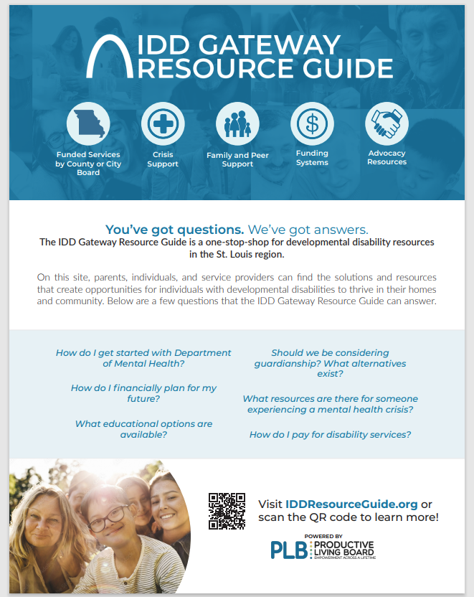
IDD Gateway Resource Guide
Designed as a resource for providers, individuals and families to access information about services in one spot.
Notes:
Tamico -

Slide 14
Questions
Notes:
All -

Slide 15
Contact Us:
Cait Carr, Family Navigator (ages 0-12)
(314) 569-2211
ccarr@slarc.org
Hannah Satterwhite, Family Navigator (ages 12-19)
(314) 569-2211
hsatterwhite@slarc.org
Tamico Jones, Director of Advocacy (all ages)
(314) 354-5629
tjones@sunnyhillinc.org
Tiff King, Family Navigator (adult)
(314) 567-7705
tiffany.king@esmw.org
Amy Meyer, Director Agency & Community Relations (PLB)
(314) 726-6016 ext. 113
ameyer@plboard.com
Family Navigator (all ages), UCP Heartland
(314) 994-1600
navigator@ucpheartland.org
Gabbi Mansell, Family Navigator (ages 20-29)
(314) 569-2211
gmansell@slarc.org
Carrie Sleme, Family Navigator (ages 30 and up)
(314) 569-2211
csleme@slarc.org
Randy Schraier, Family Navigator (adult)
(314) 567-7705
randy.schraier@esmw.org
Emily Love, Agency & Community Relations Specialist II (PLB)
(314) 726-6016 ext. 112
elove@plboard.com

